Slide 1
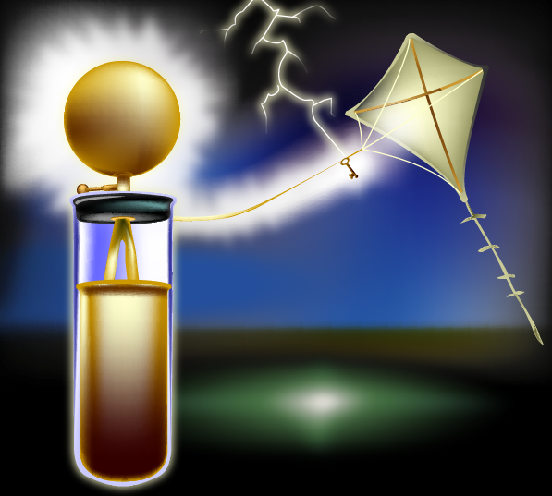
Let's Look at
Electricity
Created by Ryan Novak, Intec Specialist
School District of Lexington-Richland Counties
rnovak@lex5.k12.sc.us

Slide 2
Science Standards
4-5.5 Explain how electricity, as a form of energy, can be transformed into other forms of energy (including light, heat, and sound).
4-5.6 Summarize the function of the components of complete circuits (including wire, switch, battery, and light bulb).
4-5.7 Illustrate the path of electric current in series and parallel circuits.
4-5.8 Classify materials as either conductors or insulators of electricity. Clicking here will open a new Notebook file.
4-5.9

